Slide 1
Gene-Based Pangenome of Cucumber
Rocky Shao
2024/08/02

Slide 2



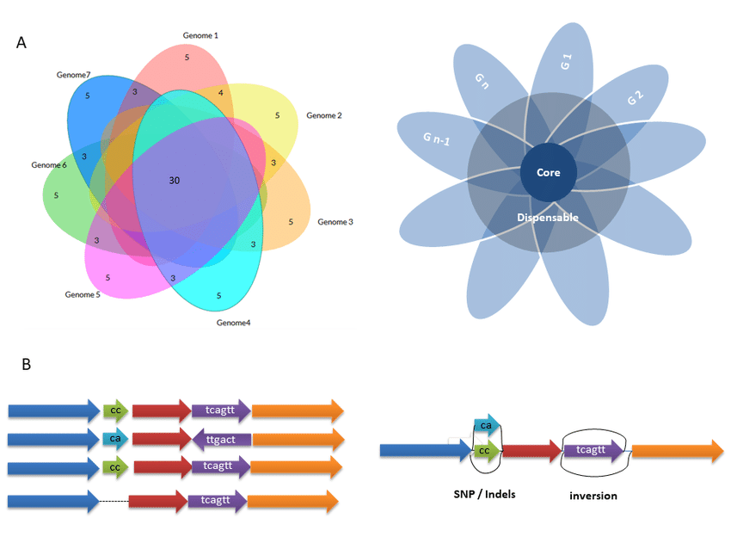
Background
Global challenges
Need more robust crop varieties
Google
Google
Technology advances
Easier to generate pangenomes
Help identify candidate genes for beneficial traits
Google
Google
Notes:
Advances in DNA sequencing technologies made it easier to generate pangenomes from representative individuals of target species. Pangenomic studies have also helped identifying beneficial traits and provided insight into breeding efforts to develop more robust crop varieties These studies have demonstrated success in recent plant research, uncovering evolution and diversity of different plant species and identifying deleterious mutations to facilitate breeding .

Slide 3
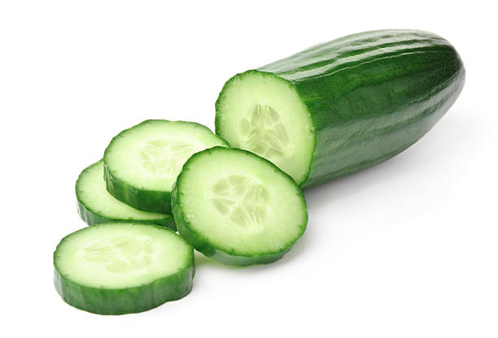
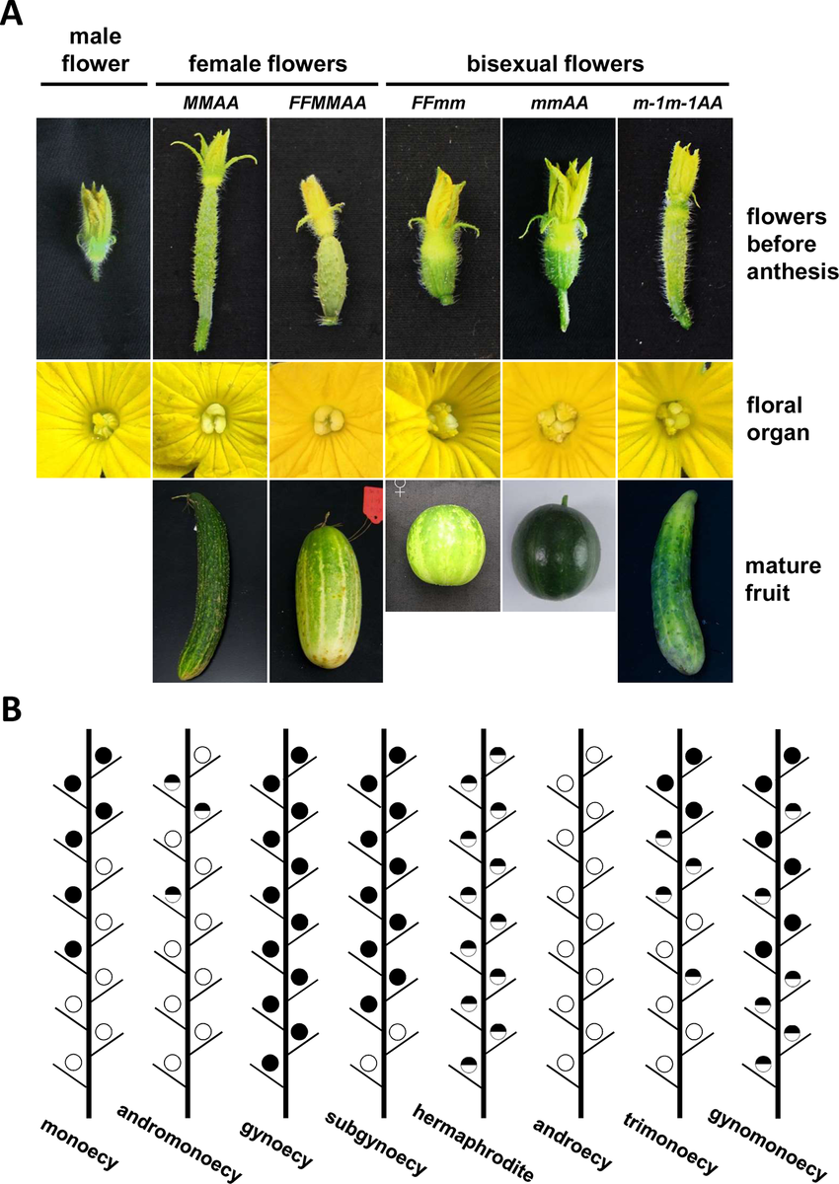
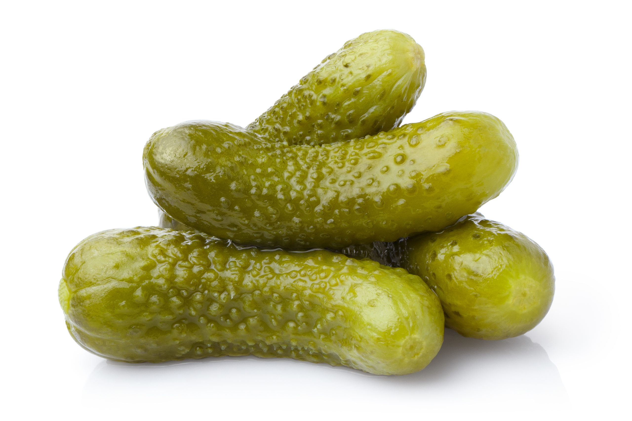
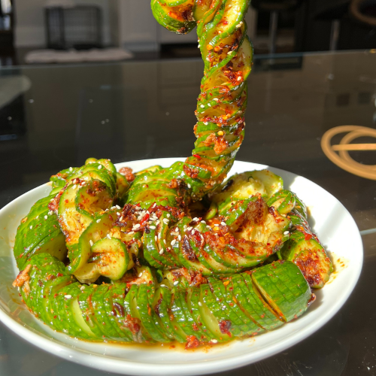
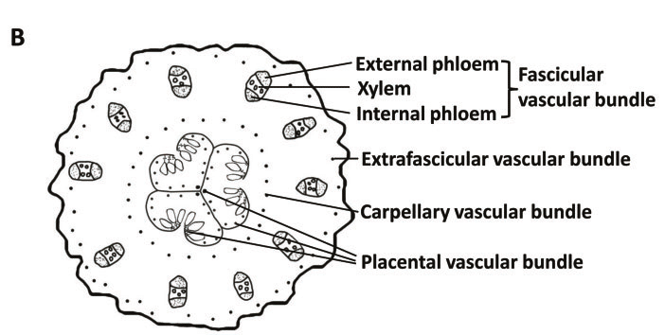

Studied Species: Cucumber
Model plant for sex determination and vascular biology studies
Important vegetable crop worldwide
Google
Google
Google
Dandan Li et.al, 2015, Frontiers in Plant Suty
Google
Jianyu Zhao et.al, 2015,Plant and Cell Physiology

Slide 4
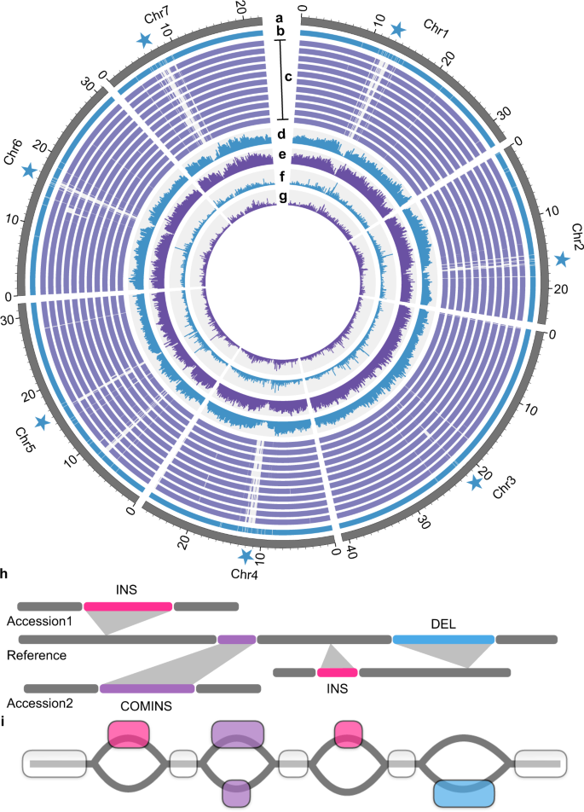
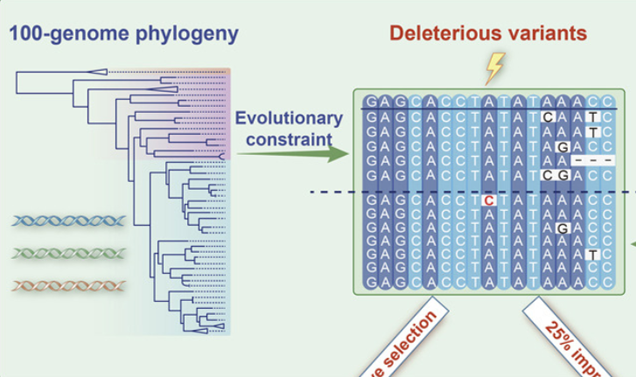
Recent pangenome study successes
Uncovered evolution and diversity of different cucumber species
Identified deleterious mutations to facilitate breeding in potato
Wu, Y., et al. Cell, 2023
Hongbo Li et.al, Nature Communications, 2022
Notes:
Previous studies have shown patterns in cucumber domestication, highlighted key genes associated with important agronomic traits and the domestication process, providing valuable information for future breeding.

Slide 5
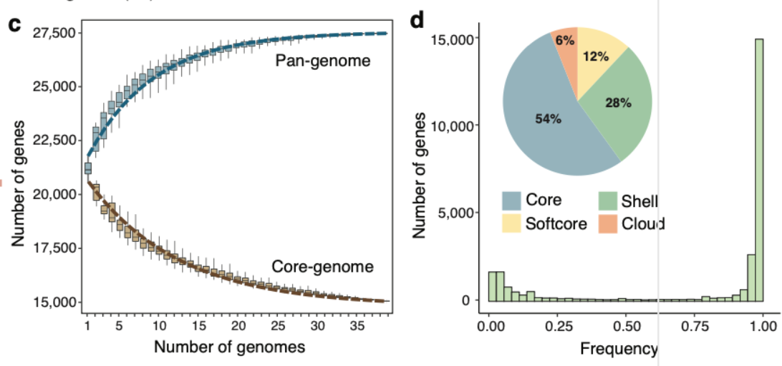
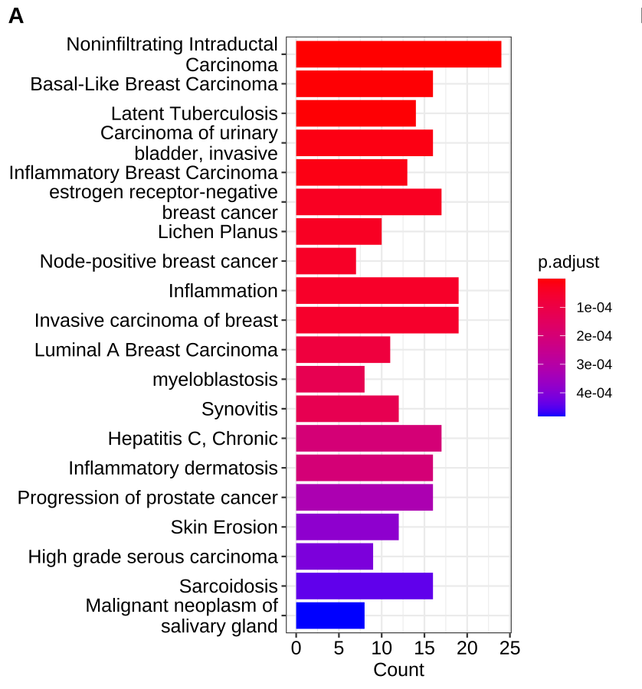
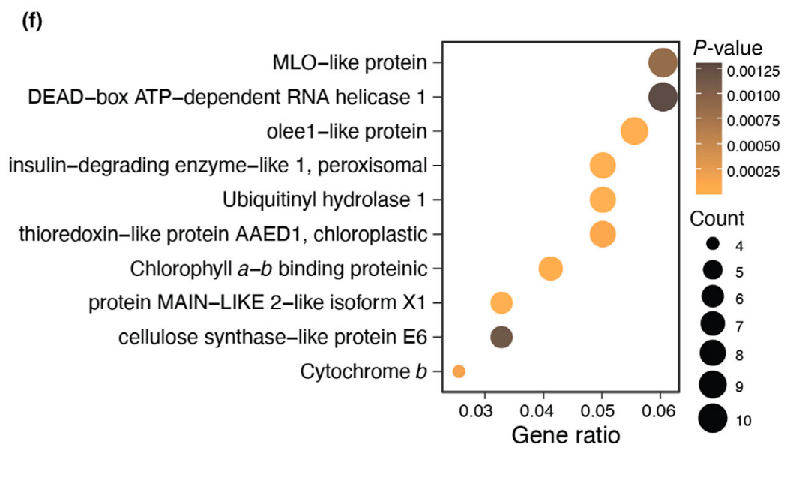

Research Goals
Gene based pangenome, all
Identify pan and core genes
Example graphs from Xuebo Zhao
Calculate PAV(Present-Absent-Variation) Frequency
Example graphs from Xuebo Zhao
Selection Analysis
Enrichment Analysis
Example graph from Xuebo Zhao
Yulab-smu.count
Google
Notes:
Halkjsl ala
Sfasf alsj fl;as
Dfaksldjflkasd
Fjasdlkfj a
Sfjlkajsd
F aps jfa

Slide 6
Procedure
Orthogroup Identification
Protein Sequence
Gene Family
Pan-Core Identification
Gene Family
Pan-Core Identification
PAV Calculation
Gene Family
PAV Calculation
Enrichment Analysis
Cultivated accessory PAV
Genes high difference of PAV in wild vs cultivated
Enrichment
Wild accessions PAV

Slide 7
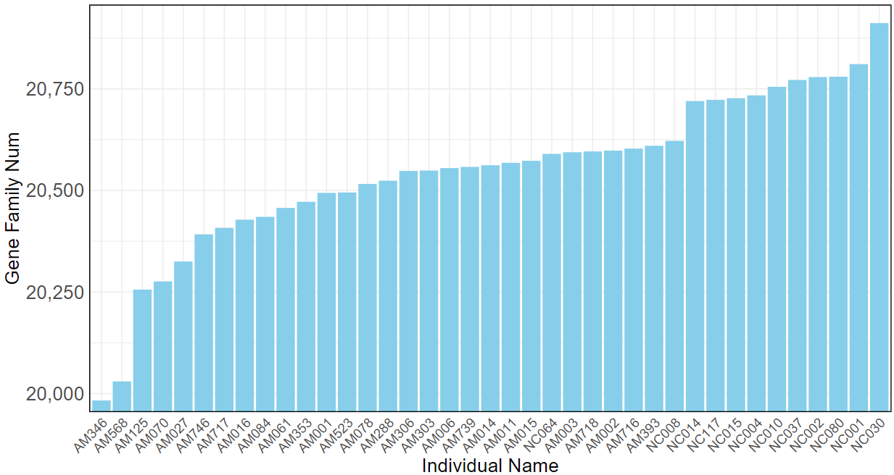
Orthogroup Identification
Protein Sequence
Orthofinder
Gene Family
Graph shows Gene-Family
Number for each sequenced cucumber individual
Highest: 21,132 gene families Mean: 20,820 gene families Lowest: 20,154 gene families
Small diversity among cucumber species

Slide 8
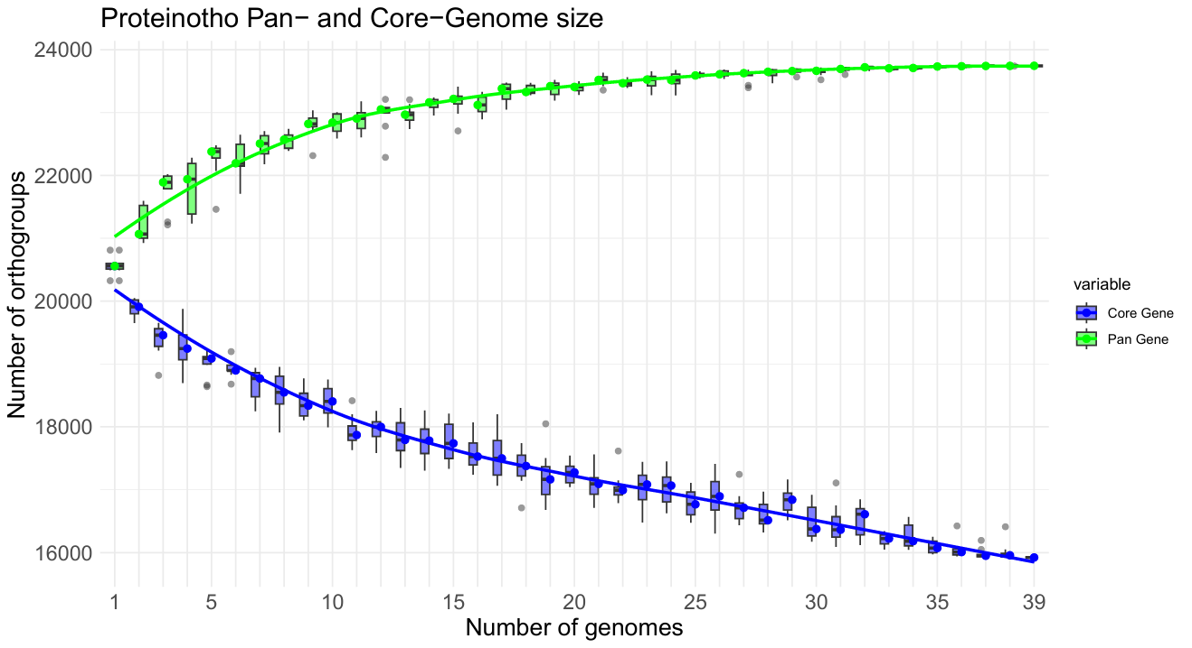
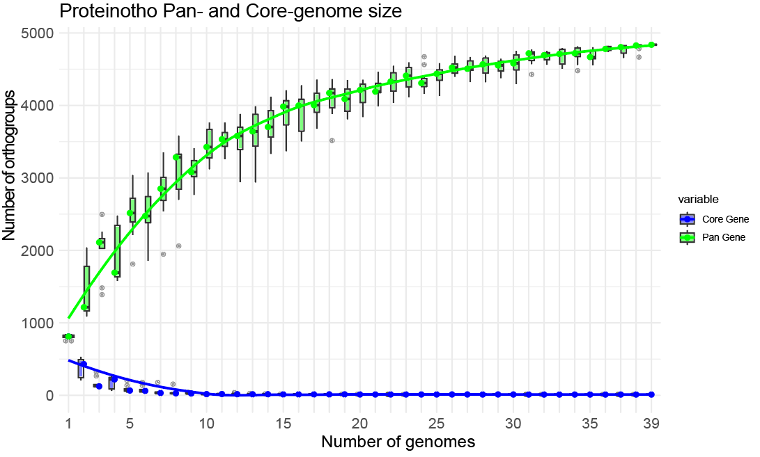
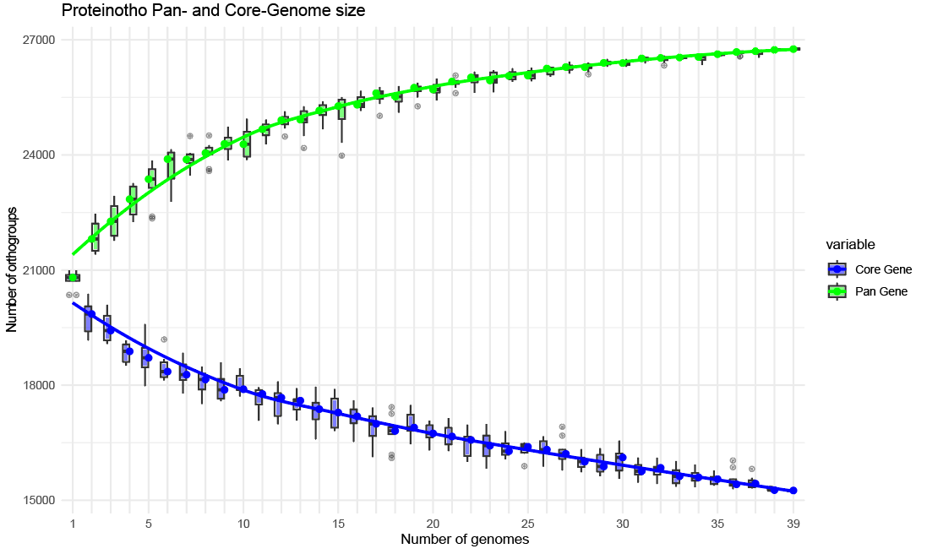
Pan-Core Identification
Gene Family
Frequency Calculation
Pan-Core Identification
I=1.5
I=30
I=10

Slide 9
Pan-Core Identification
Figure shows the curve of Pan- and Core- orthogroups with respect to increment of genomes
Orthogroup number stables around 25 genomes, suggests 39 species are suffeciet for pangenome study
I=1.5

Slide 10
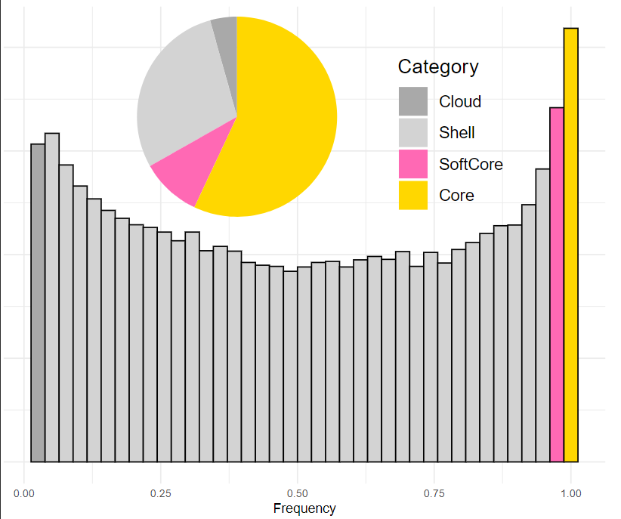
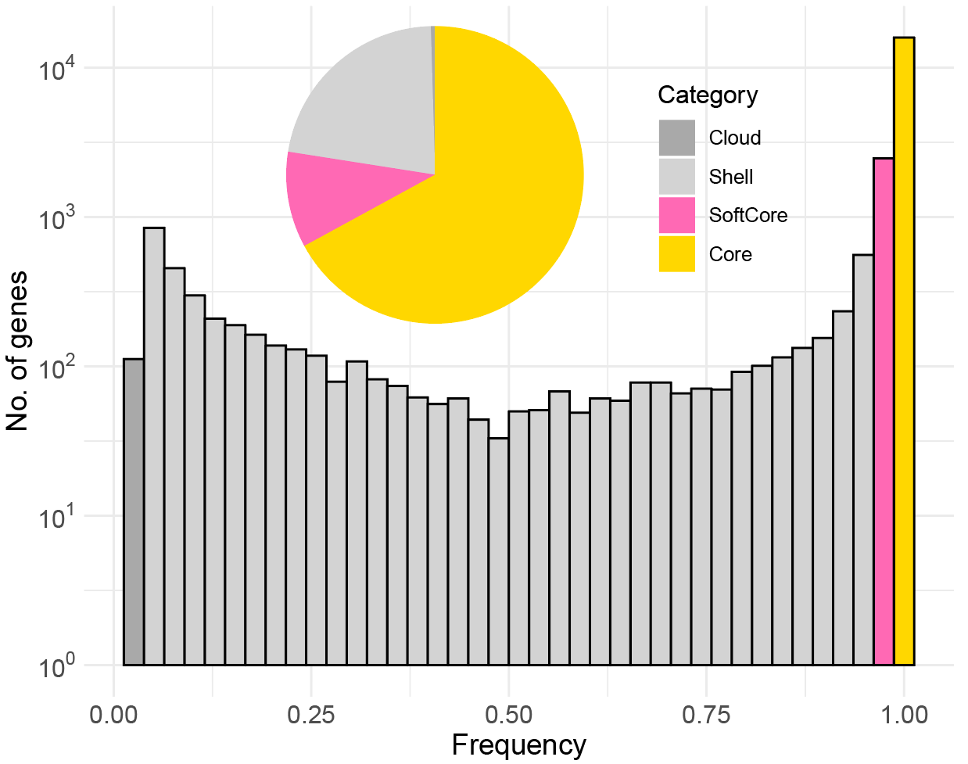
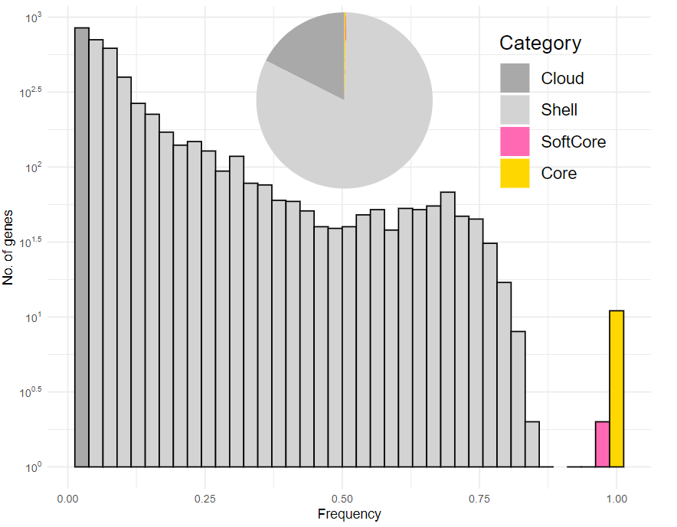
PAV Calculation
: 0% ~ 5%
: 5% ~ 95%
Gene Family
PAV Calculation
: 95% ~ 99%
: 99% ~ 100%
I=1.5
I=10
I=30

Slide 11
PAV Calculation
Figure with I=1.5 was finally chosen, as it aligns to tomato PAV calculation
High potential to identify functionally important genes, Possible to reveal genetic changes through breeding history
I=1.5

Slide 12
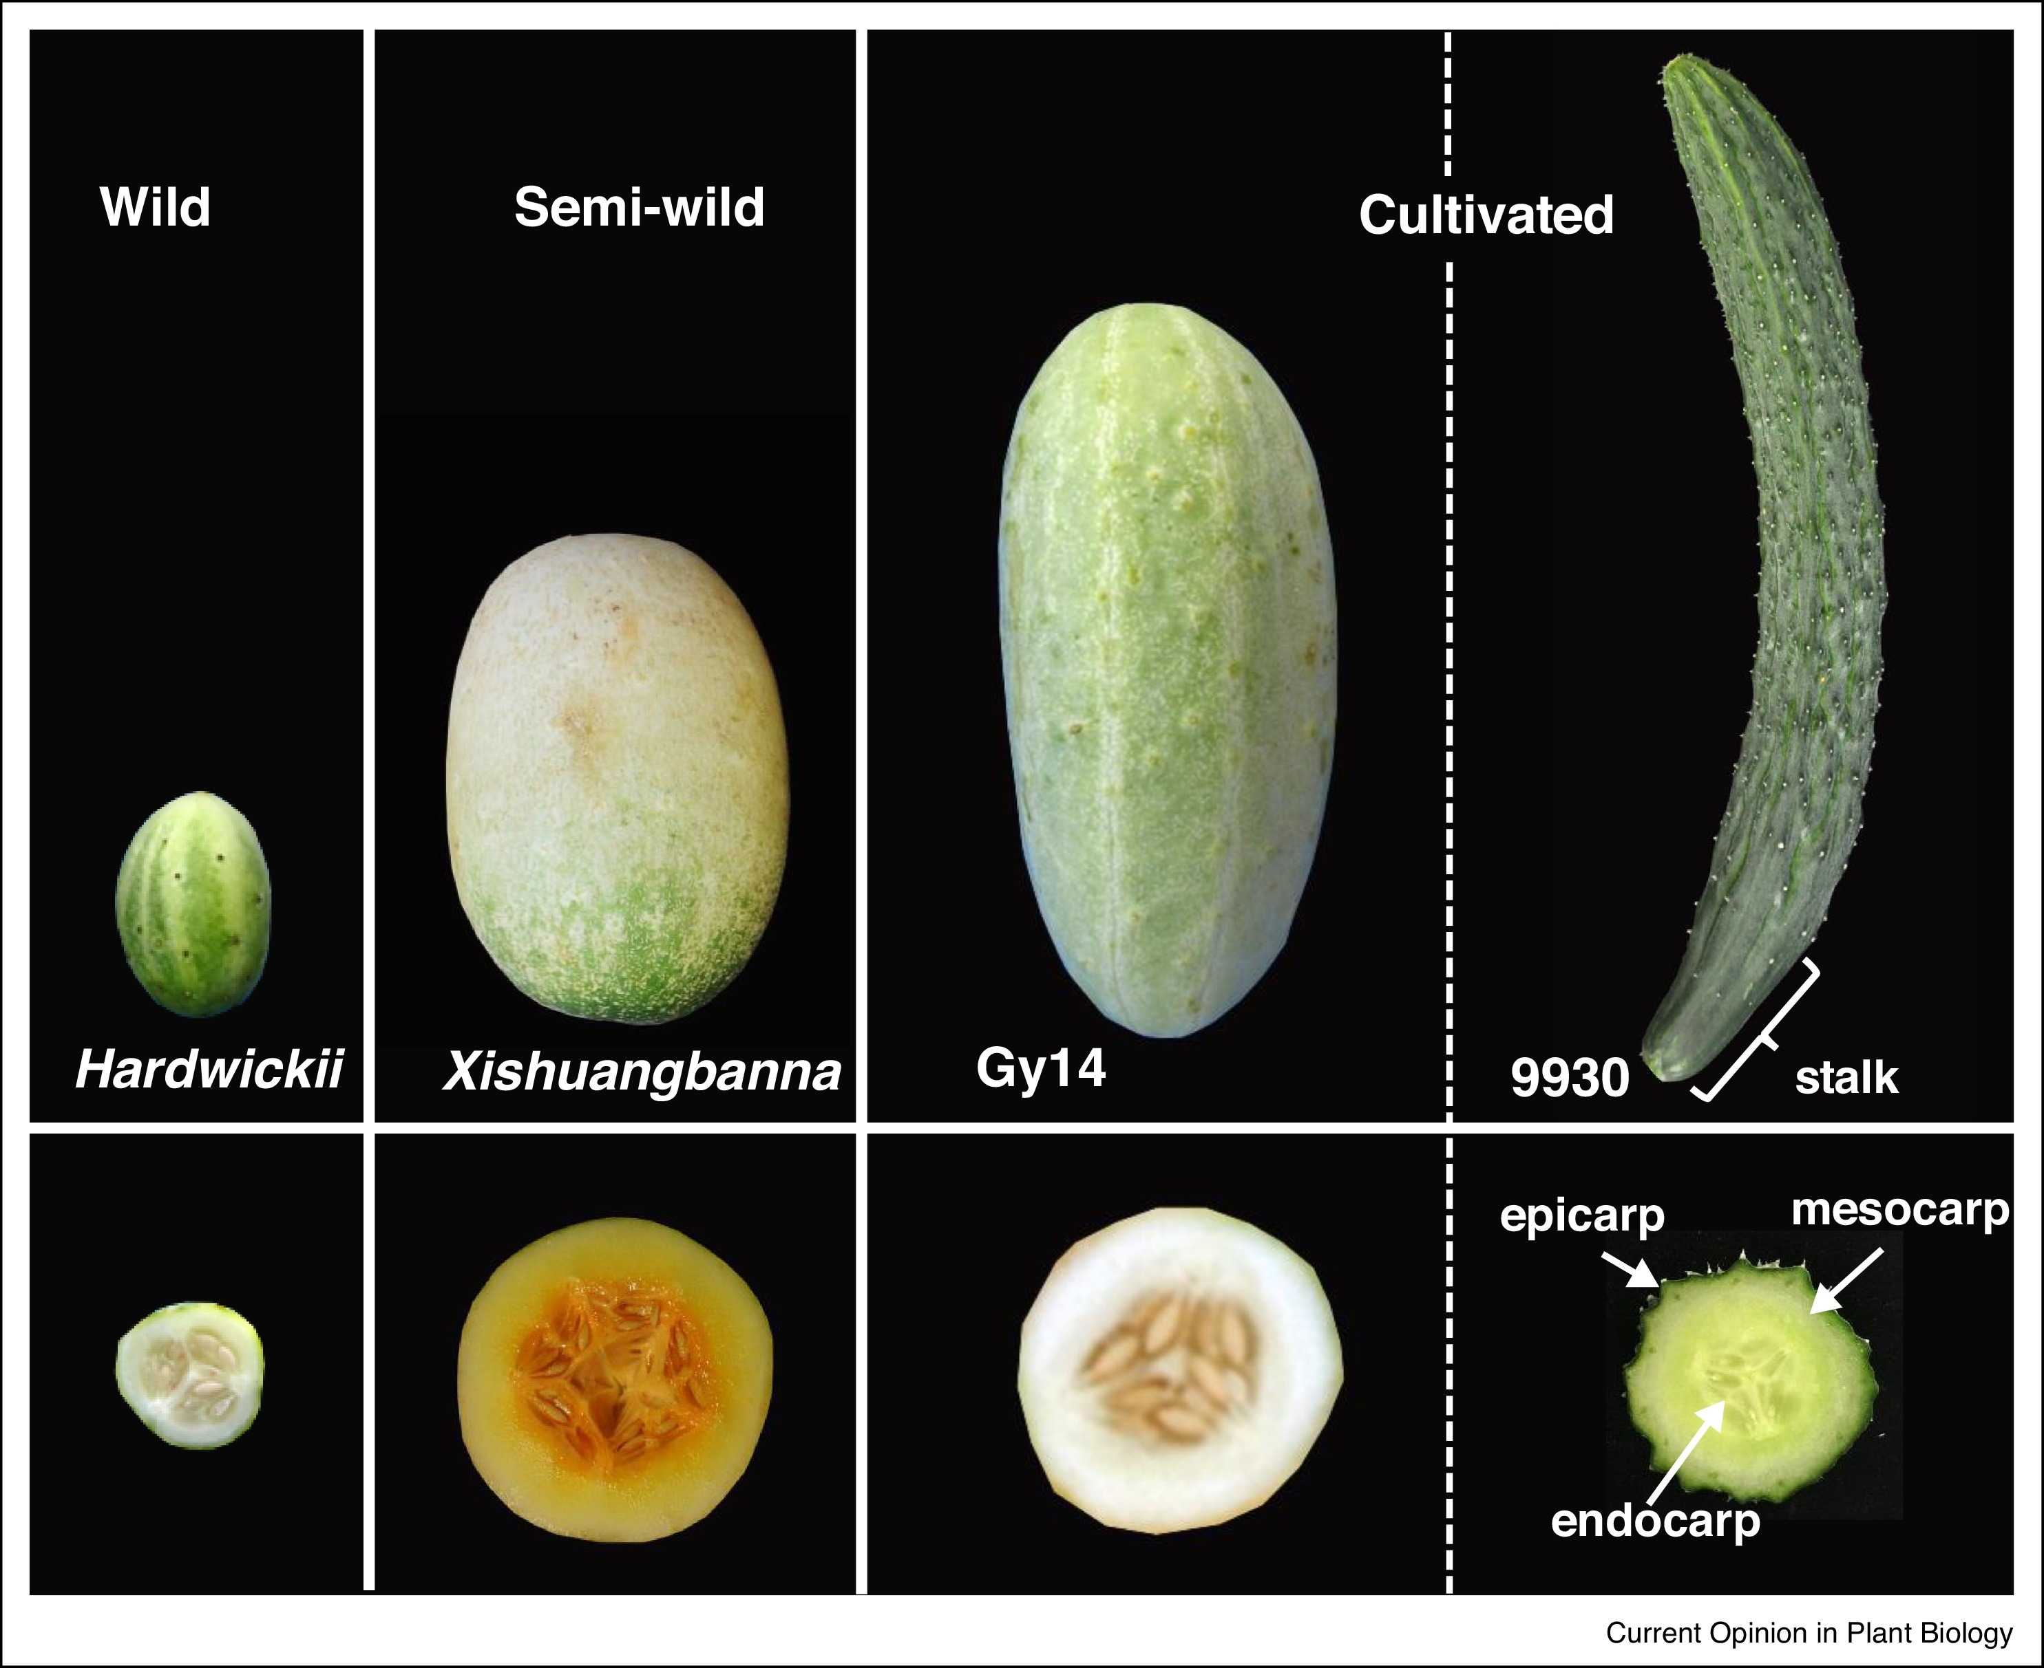
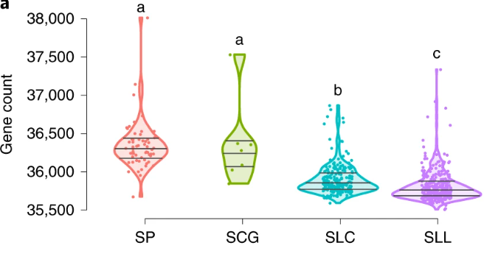
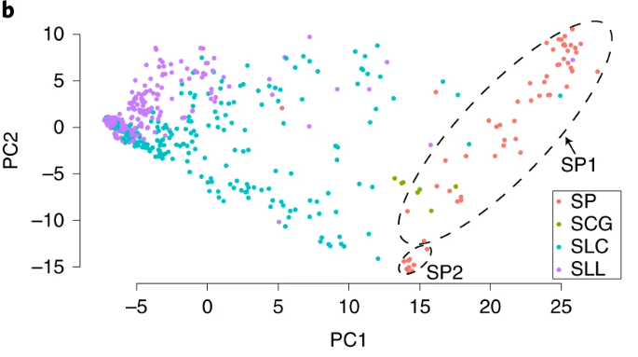
Domestication Process
,
Recent study suggest modern crop with narrow genetic diversity
Lost genes during domestication are enriched for important traits
Gen Che, Xiaolan Zhang, Elsevier, 2018
Will genes lost during cucumber domestication process also enrich for important traits?
Lei Gao et.al, Nature Genetics,2019

Slide 13
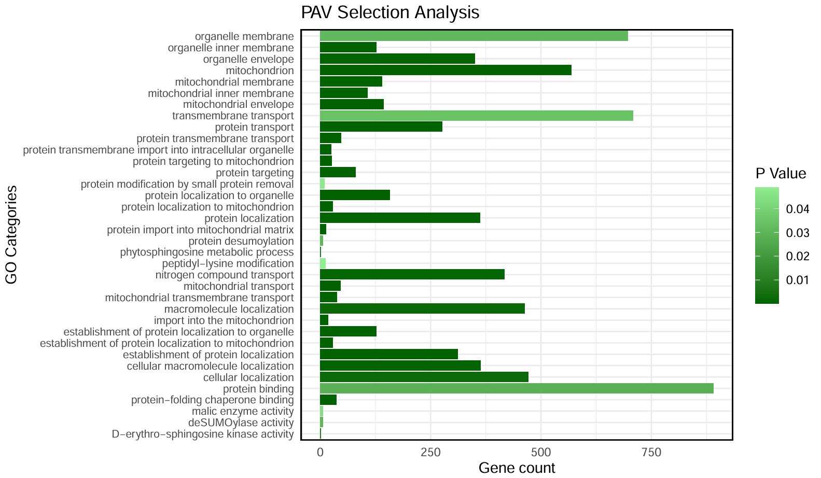
Enrichment Analysis
Cultivated accessions PAV
Genes high difference of PAV in wild vs cultivated
Enrichment
Wild accessions PAV
Cucumber species exhibit significant gene enrichment in mitochondrial functions and protein transport, indicating essential roles in energy production and cellular organization.

Slide 14
Summary
Constructed gene-based pangenome of 39 cucumber genome.
Identified 15,924 core-genes, 2,474 soft-core genes, 5,235 shell genes and 112 Cloud-genes in cucumber gene-based pangenome
Through PAV calculation, identified 2193 genes with high PAV frequency in wild vs cultivated cucumber species, enriched in mitochondrial functions and protein transport
This project provided resource for cucumber pangenome studies, identified genes with different PAV in wild vs domesticated species, and provided value in future cucumber breeding

Slide 15
Thank U :P

